Slide 1

Bootstrap part 2
Let’s know more about Bootstrap Framework
Prepared by Helena Natanael, for FWD by dibimbing.id

Slide 2

1
Bootstrap Forms
2
Bootstrap Navbar
Outline
3
Bootstrap Buttons
4
Bootstrap Icons

Slide 3
Introduction to Figma
Figma is a useful tool that usually used in companies to support the work between UI/UX and Front-End Engineer
1 of 11

Slide 4
Slicing: terms that used by FE to describe activity of developing a Web Page based on a design
Figma Project Link that we will slice in BS2 and BS3: https://www.figma.com/file/KGFvLbJYrmWZHIvQLGwsQJ/Ecommerce-site-mobile-and-screens-(Community)?node-id=220%3A8035
2 of 11

Slide 5
Bootstrap Forms
Forms are used as the most common way to input data in websites.
Bootstrap forms enrich the form input using their classes.
1 of 11

Slide 6
Bootstrap Forms
There are 2 kind of textual form controls: <input> tag and <textarea> tag.
We can add predefined Bootstrap Forms to ease styling the form controls, like
.form-control-[size] to set height for the form (example: .form-control-lg for large height)
We can also add attribute in our form to suit our needs:
1. disabled attribute to add grayed layout and prevent user to add input in the form element
2. readonly attribute, similar to disabled but with some value inside the form element, prevent user to modify the form element.
2 of 11

Slide 7
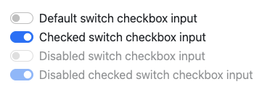
Bootstrap Form Components
Similar to the basic HTML, Bootstrap Form Components consists of:
Select
Input (Checkbox, Text, File, Radio, Color)
Bootstrap Form Components also leverage the usage of some components, for example is Switches, it’s upgraded from input checkbox.
3 of 11

Slide 8
Hands-On
Let’s do the hands-on coding to understand more!
4 of 11

Slide 9
Ice Breaking

Slide 10
Bootstrap Navbar
Navbar is a component in HTML that usually used to help users navigate on the webpage.
5 of 11

Slide 11
Bootstrap Navbar
To use Bootstrap’s Navbar, we need to add class .navbar and add some subclasses:
1. .navbar-brand to add company, product, or project name (can be a text or logo)
2. .navbar-nav to make a full-height navigation
3. .navbar-toggler to use collapse plugin and navigation toggler
4. .navbar-text to add vertically centered text
5. .collapse.navbar-collapse for grouping and hiding navbar contents
6 of 11

Slide 12
Hands-On
Let’s do the hands-on coding to understand more!
7 of 11

Slide 13
Bootstrap Buttons
Buttons used in form to trigger some state change and execute some function
7 of 18

Slide 14
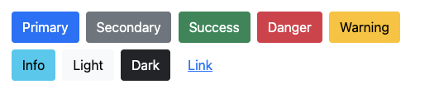
Bootstrap Buttons
Bootstrap provide various buttons styling:
.btn-primary
.btn-secondary
.btn-success
.btn-danger
.btn-warning
.btn-info
.btn-light
.btn-dark
.btn-link
8 of 18

Slide 15
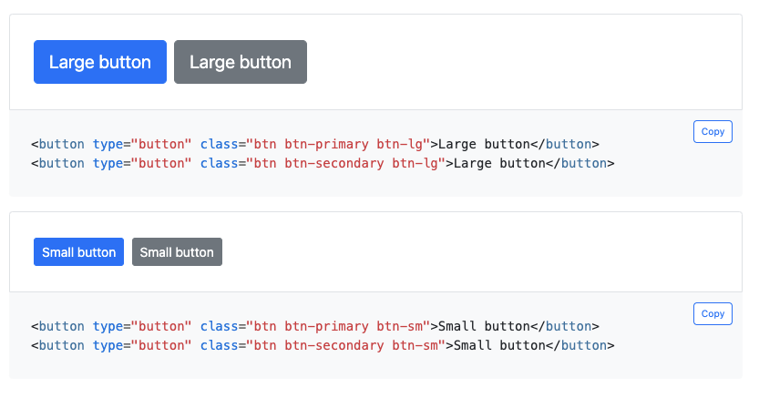
Bootstrap Buttons
We can also use Bootstrap’s size state to style the buttons.
9 of 18

Slide 16
Hands-On
Let’s do the hands-on coding to understand more!
10 of 18

Slide 17
Bootstrap Icons
Icons might not be seen as a necessary part of a website, however it takes a big part in giving a good impression of user experience.
8 of 11

Slide 18
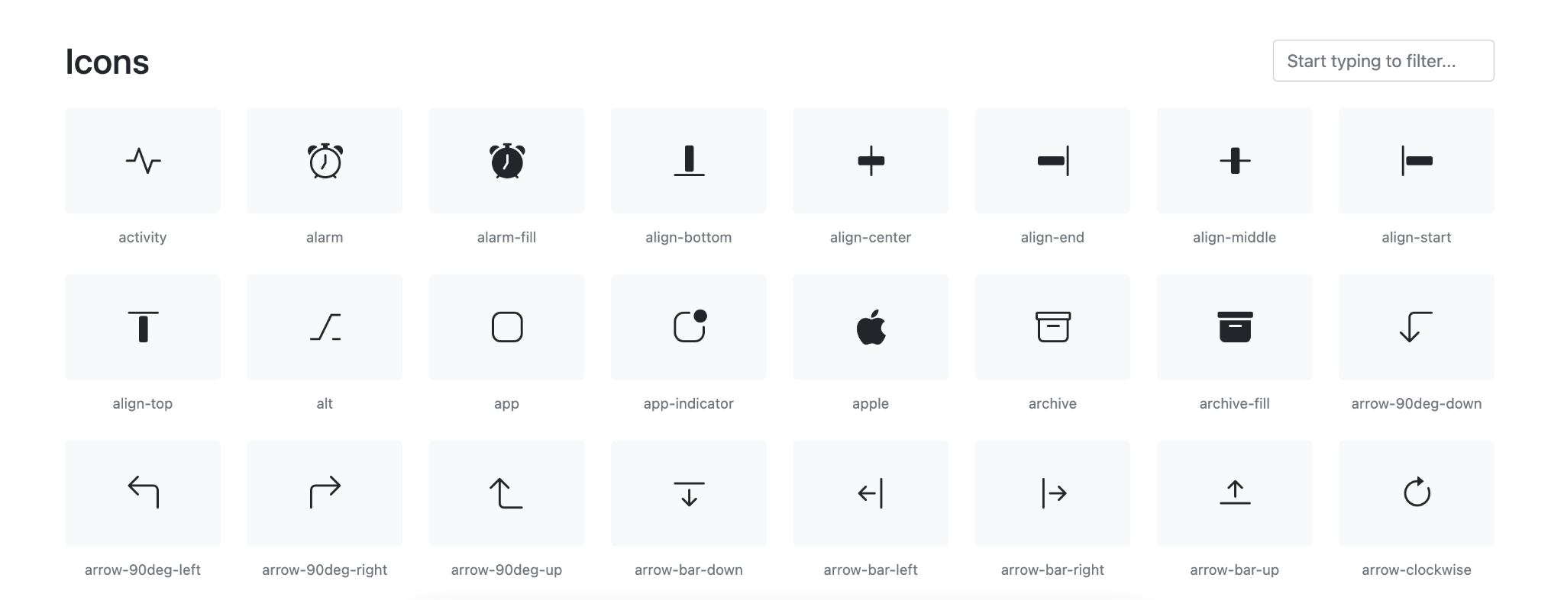
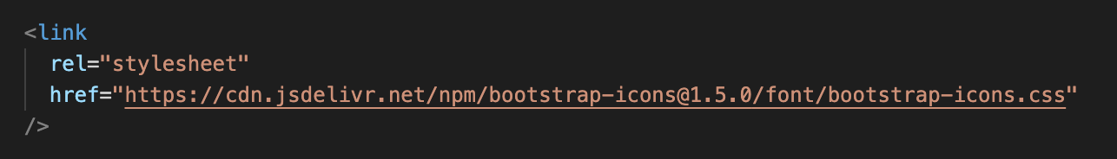
Bootstrap Icons
At first Bootstrap is cooperating with Glyphicons to provide icons, however recently Bootstrap launch its own icons.
We need to import this script in our head tag to get started:
9 of 11
Notes:
https://icons.getbootstrap.com/

Slide 19
Hands-On
Let’s do the hands-on coding to understand more!
10 of 11

Slide 20
Thank you
That’s all for this session!
References: https://getbootstrap.com/docs/5.2/forms/overview/
https://getbootstrap.com/docs/5.2/components/navbar/
https://icons.getbootstrap.com/
Prepared by Helena Natanael, for FWD by dibimbing.id

